Slide 1
CHAPTER 4
INDUCTION AND RECURRENCES

Slide 2
CONTENTS
4.1 Induction
4.2 Recursion

Slide 3
4.1 Induction
4.1.1 Ordinary Induction
4.1.2 Strong Induction
4.1.3 Inductive Definitions

Slide 4
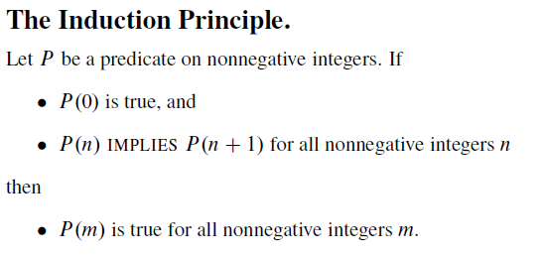
4.1.1 Ordinary induction

Slide 5
Example: Prove that for all n ∈ℕ, we have

Slide 6
4.1.2 Strong Mathematical Induction
Theorem. Let P(n) be a predicate with the universe of discourse N. Assume that
P(0) is true
∀n, (P(0) ∧ P(1) ∧ … ∧ P(n)) → P(n +1)
Then ∀n, P(n) is true
In our proofs, to show P(k+1), our inductive hypothesis assures that ALL of P(0), P(1), … P(k) are true, so we can use ANY of them to make the inference.

Slide 7
Prove that the Fibonacci sequence
a₀ =1 , a₁= 1,
a_{k+1} = a_{k} + a_{k-1} for k ≥ 1
satisfies

Slide 8
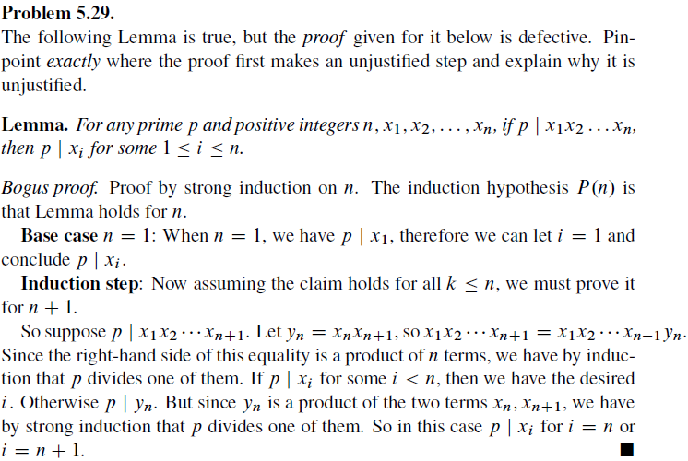

Slide 9
4.1.3 Inductive Definitions
We completely understand the function f(n) = n !, right?
As a reminder, here’s the definition:
n ! = 1 · 2 · 3 · … · (n –1) · n, n ≥ 1
But equivalently, we could define it like this:
Recursive Case
Base Case
Inductive (Recursive) Definition

Slide 10
4.1.3 Inductive Definitions
Another VERY common example:
Fibonacci Numbers
Base Cases
Recursive Case
Is there a non-recursive definition for the Fibonacci Numbers?

Slide 11



Fibonacci numbers
Exercise: Prove, using strong induction, the following closed-form formula for the Fibonacci numbers

Slide 13
Fibonacci numbers
Fibonacci numbers arise in all sorts of applications
and in nature. For example,
The recurrence was introduced by Fibonacci himself in thirteenth century to model rabbit reproduction.
The sizes of the spiral patterns on the face of a sunflower grow in proportion to Fibonacci numbers.
The input values on which Euclid’s gcd algorithm requires the greatest number of steps are consecutive Fibonacci numbers.

Slide 14
4.2 Recurrences
A recurrence describes a sequence of numbers. Early terms are specified explicitly, and later terms are expressed as a function of their predecessors.
Example: Fibonacci numbers

Slide 15
Example. How many bit strings of length n do not contain two consecutive bit 0?
Let a_{n} be the number of such strings, and x₁x₂ …x_{n} be such a string:
if x_{n} = 1 then the string is x₁x₂ …x_{n – 1}1, where x₁x₂ …x_{n - 1} is an arbitrary string of length n – 1 without two consecutive bit 0: there are a_{n - 1} such strings
if x_{n} = 0 then the string is x₁x₂ …x_{n - 2}10, where x₁x₂ …x_{n - 2} is an arbitrary string of length n – 2 without two consecutive bit 0: there are a_{n - 2} such strings
Thus a_{n} = a_{n - 1} + a_{n - 2}
This is an example of a recurrence relation

Slide 16
Modeling with Recurrence Relations
Example: A sum of P₀ is deposited in the saving account with the interest rate of r compounded annually. How much will be in the account after n years?
Solution:
Let P_{n} be the amount after n years, then P_{n} is obtained from P_{n – 1} and the interest yielded from that amount in one year:
P_{n} = P_{n – 1} + r P_{n – 1} = (1+r) P_{n – 1}

Slide 17
Modeling with Recurrence Relations
Solution:
Let P_{n} be the amount after n years, then :
P_{n} = P_{n – 1} + r P_{n – 1} = (1+r) P_{n – 1}
This is a geometric progression.
The solution of this relation is obtained as follows:
P_{n} = (1+r) P_{n – 1} = (1+r)² P_{n – 2} = … = (1+r)^{n} P₀
P_{n} = (1+r)^{n} P₀

Slide 18
Modeling with Recurrence Relations
In this section, we’ll emphasize using recurrences to analyze the performance of recursive algorithms.
Recurrences are one aspect of a broad theme in computer science: reducing a big problem to progressively smaller problems until easy base cases are reached. This same idea underlies both induction proofs and recursive algorithms. As we’ll see, all three ideas snap together nicely. For example, the running time of a recursive algorithm could be described with a recurrence with induction used to verify the solution.

Slide 19
There are several methods for solving recurrence equations.
The simplest is to guess the solution and then verify that the guess is correct with an induction proof.

Slide 20
The Towers of Hanoi Problem
According to legend, there is a temple in Hanoi with three posts and 64 gold disks of different sizes. Each disk has a hole through the center so that it fits on a post.
In the misty past, all the disks were on the first post, with the largest on the bottom and the smallest on top.

Slide 21
Monks in the temple have labored through the years since to move all the disks to one of the other two posts according to the following rules:
The only permitted action is removing the top disk from one post and dropping it onto another post.
A larger disk can never lie above a smaller disk on any post.
The legend says that when the monks complete the puzzle, the world will end!

Slide 22
Question
“Given sufficient time, can the monks succeed?”
If so, “How long until the world ends?”

Slide 23
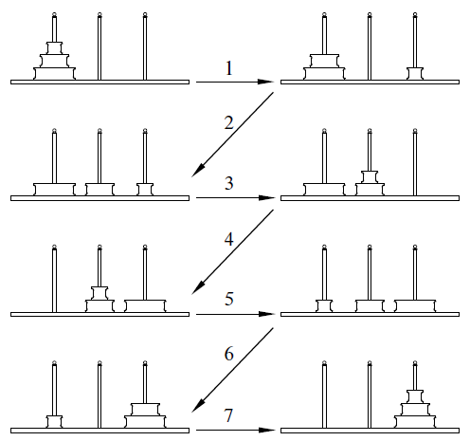

Slide 24
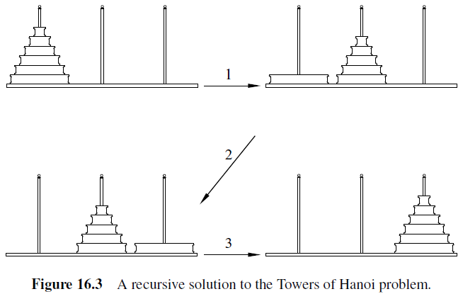

Slide 25
A recursive solution
Stage 1. Move the top n-1 disks from the first post to the second using the solution for n-1 disks. This can be done in t_{n-1} steps.
Stage 2. Move the largest disk from the first post to the third post. This takes just 1 step.
Stage 3. Move the n-1 disks from the second post to the third post, again using the solution for n -1 disks. This can also be done in t_{n-1} steps.
This algorithm shows that t_{n}, the minimum number of steps required to move n disks to a different post, is at most t_{n-1} + 1+ t_{n-1} = 2t_{n-1} + 1.

Slide 26
Find a closed formula for T_{n}
We have T_{n} = 2 T_{n-1} +1
Let’s guess the formula
T₁ = 1
T₂ = 3
T₃ = 7
T₄ = 15
T₅ = 31

Slide 27
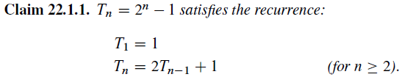
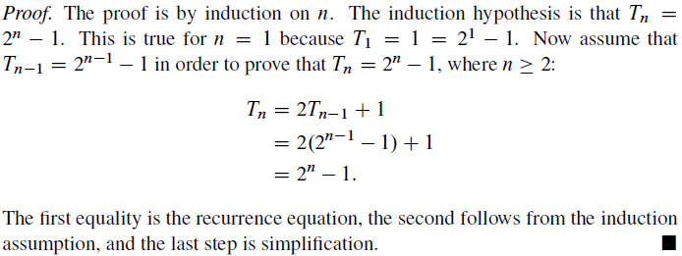

Slide 28
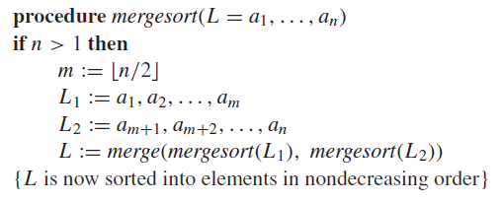
MERGE SORT ALGORITHM
The input is a list of n numbers, and the output
is those same numbers in nondecreasing order.

Slide 29
Merging two lists
procedure merge(L1,L2 : sorted lists)
L := empty list
while L1 and L2 are both nonempty
Remove the smaller of first elements of L1 and L2 from its list; put it at the right end of L
If this removal makes one list empty then remove all elements from the other list and append them to L
return L
(L is the merged list with elements in increasing order)

Slide 30
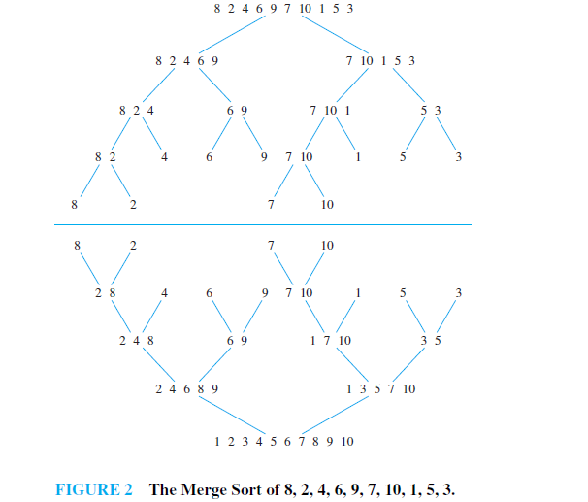
Notes:
Algorithms textbooks traditionally claim that sorting is an important, fundamental
problem in computer science. Here, we’ll cover just one
well-known sorting algorithm, Merge Sort. The analysis introduces another kind of
recurrence.
Here is how Merge Sort works. The input is a list of n numbers, and the output
is those same numbers in nondecreasing order.

Slide 31
Merge sort
What is the maximum number of comparisons used in sorting n items?

Slide 32
Finding a recurrence
Let T_{n} be the maximum number of comparisons used while Merge Sorting a list of n numbers.
Assume that n is a power of 2 (so the input can
be divided in half at every stage of the recursion).
If there is only one number in the list, then no comparisons are required, so T₁ = 0.
Otherwise, T_{n} includes comparisons used in sorting the first half (at most T_{n/2}), in sorting the second half (also at most T_{n/2}), and in merging the two halves. The number of comparisons in the merging step is at most n-1.

Slide 33

For n ≥ 2 and a power of 2
The closed-form for T_{n}
T_{n} = n log n – n + 1
Notes:
log n = log₂ n

Slide 34
Solving linear recurrence
Definition: A linear homogeneous recurrence relation of degree k is a recurrence relation of the form
where c₁, c₂, …, c_{k} are real numbers, c_{k} ≠ 0.
Example: Fibonacci

Slide 35
Solving linear recurrence
Find the explicit formula for f(n)
Solve the characteristic equation
Case 1: The characteristic equation has two distinct root r₁, r₂.
Case 2: The characteristic equation has only one root r₀.

Slide 36
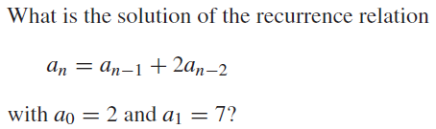
Example
Solution.
The characteristic equation : r² – r -2 = 0 has distinct roots r₁ = 2 and r₂ = -1. Therefore,
a_{n} = c₁ 2^{n} + c₂ (-1)^{n}
for some c₁, c₂ . From the initial conditions, it follows that
a₀ = 2 = c₁ 2⁰ + c₂ (-1)⁰
a₁ = 7 = c₁ 2 + c₂ (-1)
So we get c₁ = 3, c₂ = -1. Hence, the solution of the recurrence relation is
a_{n} = 3. 2^{n} – (-1)^{n} .

Slide 37
Find the closed formula for Fibonacci numbers
F(0) = 0
F(1) = 1
F(n) = F(n-1) + F(n-2)

Slide 38
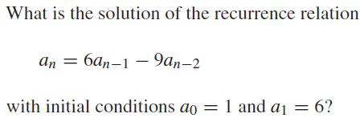
Example

Slide 39


Solving general linear recurrence
Theorem. Let c₁, c₂, …, c_{k} be real numbers. Suppose that the characteristic equation
has k distinct roots r₁, …, r_{k}. Then a sequence {a_{n}} is a solution of the recurrence relation
if and only if

Slide 40
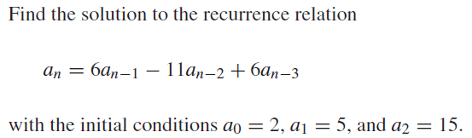
Example

Slide 41
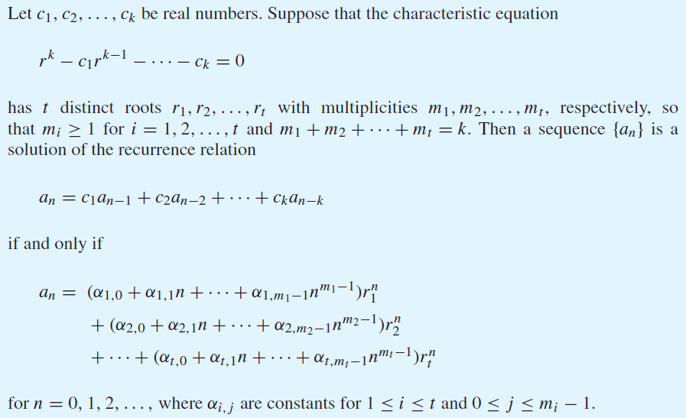
Theorem

Slide 42
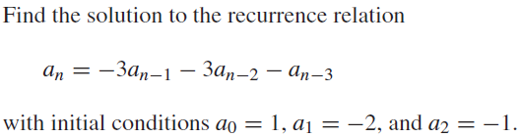
Example

Slide 43
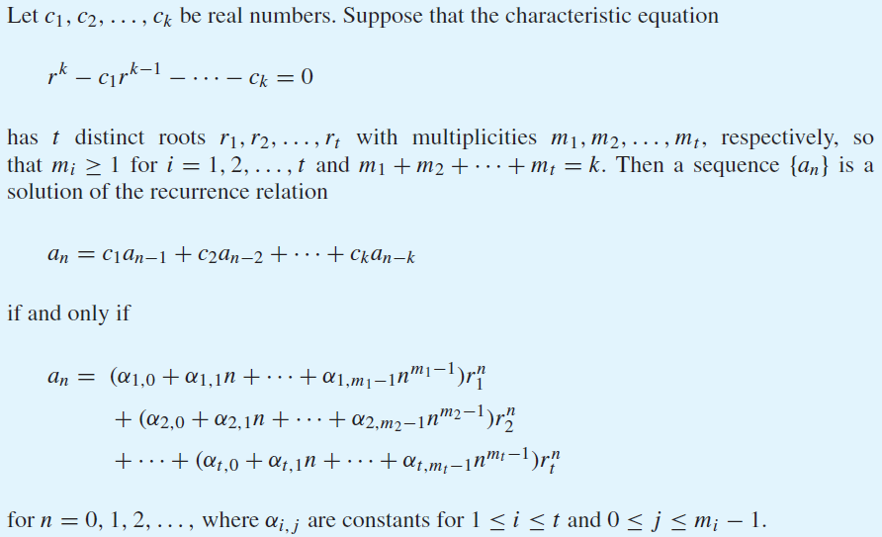
Theorem

Slide 44
Solving inhomogeneous linear recurrence
1. Find roots of the characteristic equation.
2. Write down the homogeneous solution to the homogeneous recurrence
3. Now restore g(n) and find a single solution G(n) to the recurrence, ignoring boundary conditions. This is called a particular solution.
4. Add the homogeneous and particular solutions together to obtain the general solution F(n) + G(n)
5. Now use the boundary conditions to determine constants.

Slide 45


Example: Solve the recurrence relation
Solution
Solving the homogeneous recurrence
F(n) = 2F(n-1)
we get the homogeneous solution: F(n)=c 2^{n}
Let’s guess that there is a particular solution of the form G(n) = a n + b
Substituting this guess into the recurrence gives
We deduce that a= -1, b= -2

Slide 46
The general solution to the recurrence
f(n) = c2^{n} – n – 2.
Using the boundary condition f(1) = 1, we get
1= f(1) = c.2 – 1 – 2
So c = 2.
Therefore, f(n) = 2. 2^{n} – n – 2 .

Slide 47
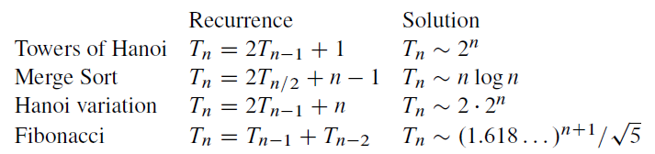
Solution of well-known recurrences

Slide 48
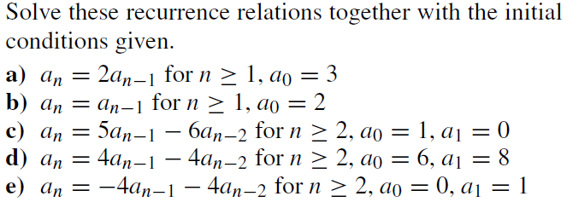

Slide 49
